Slide 1
SAP HANA
Lesson Name: Introduction to SAP HANA
Notes:
Add instructor notes here.

Slide 2
Contents
Introduction to SAP HANA
Evolution of ABAP For SAP HANA
HANA Architecture
SAP In-Memory
SAP HANA Database Concepts
Row Store
Column Store
Database Compression
Code Pushdown
Data Provisioning

Slide 3
Lesson Objectives
After completing this lesson, participants will be able to -
Know about SAP HANA
Understand HANA Architecture
Understand SAP In-Memory Concept
Understand HANA Database Concepts
Know about Database tables -
Row Store
Column Store
Understand Data Provisioning
Notes:
Add instructor notes here.

Slide 4
Introduction to SAP HANA
SAP stands for System, Application, Product in Data Processing.
HANA stands for High-performance Analytic Appliance.
SAP HANA is a flexible, data-source-agnostic appliance that enables customers to analyze large volumes of SAP-ERP data in real-time.
It avoids the need to materialize transformations.
Notes:
Add instructor notes here.

Slide 5
Introduction to SAP HANA
SAP HANA appliance software is a hardware and software combination that integrates a number of SAP components.
Components include in memory SAP HANA Database, Replication Server, Session Management , disk storage, persistence layer, relational engines and responds to SQL queries.
SAP HANA database consists of multiple servers and the most important component is the Index Server. SAP HANA database consists of Index Server, Name Server, Statistics Server, Preprocessor Server and XS Server(Built-in application server). From release SPS11, SAP delivers more powerful XS server which is called XS Advance.
SAP HANA Database is a hybrid in-memory database that combines row-based, column-based, and object-based database technology.
Notes:
Add instructor notes here.

Slide 6
Introduction to SAP HANA
HANA is a Breakthrough Technology
SAP HANA is a SQL database where all data is stored in-memory. Of course, it is much more complex:
HANA is sold as an appliance with dedicated hardware (provided by IBM, HP, Fujitsu, Cisco, Dell and more recently Hitachi)
It contains Solid State Disks (SSD) to store the updating logs (to respect ACID properties)
All data is regularly saved to classic Hard Disk Drives (HDD) to allow a reboot in case of a power cut for instance
The HANA license includes a modeling tool
The HANA license includes a loading or a replication tool.
Notes:
Add instructor notes here.

Slide 7
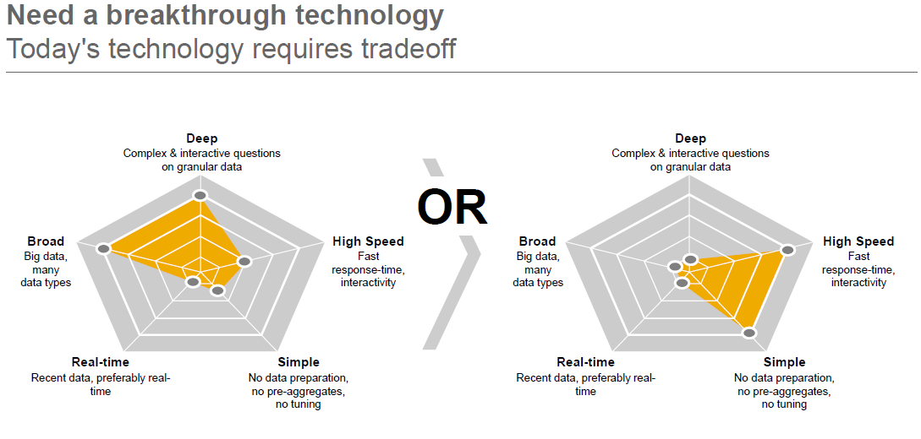
Introduction to SAP HANA
Before HANA, developing applications required several trade of decisions. Picture above, shows five typical dimensions while building a business applications. As an example, we may have to decide between providing a high-speed application and developing an application which does not required special preparation of processing data e.g. calculating aggregations beforehand and sorting the result set. Also it was very difficult to develop an application which is both real-time and able to analyze a large amount of data.
Notes:
Add instructor notes here.

Slide 8
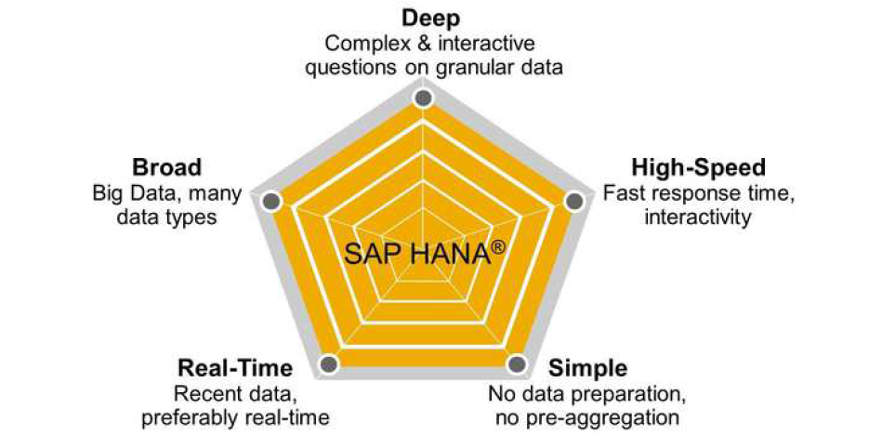
Introduction to SAP HANA
SAP HANA tries to deliver across all these five dimensions, so that you no longer have to make so many trade-off decisions. The goal is to enable the development of applications that combine Online Transaction Processing (OLTP) and Online Analytical Processing (OLAP) usage patterns.

Slide 9
Introduction to SAP HANA
Break-through Technology:
The application developed so far will acknowledge the fact that this typically requires making several trade-off decisions.
Trade Off is a situation that involves losing one quality or aspect of something in return for gaining another quality or aspect. If one thing increases, some other thing must decrease
The graphics on the slide show the five dimensions of requirement that are typically required for a business applications.
With a traditional database, addressing these all 5 dimensions have been conflicting so far and challenged developers very badly.
Development of an application which is both real-time and able to analyze a large amount of data at the same time is not possible.
Notes:
Add instructor notes here.

Slide 10
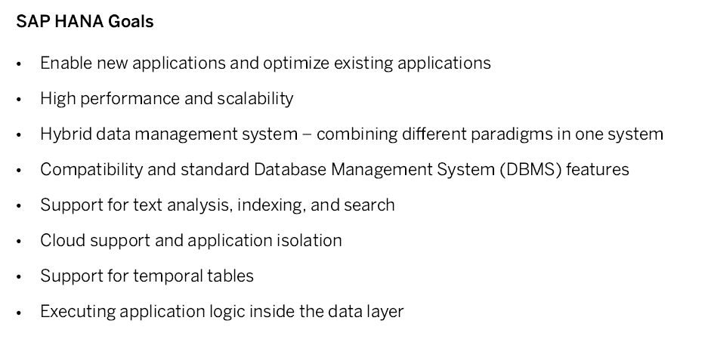
Introduction to SAP HANA

Slide 11
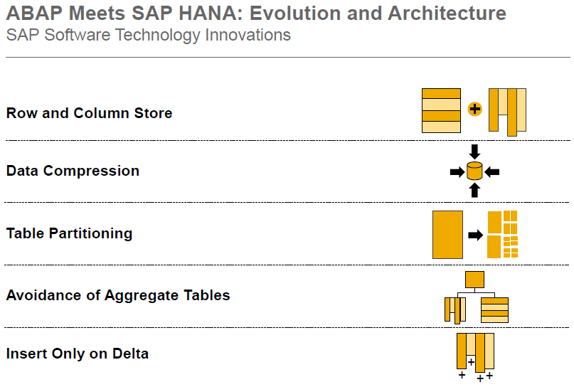
Introduction to SAP HANA
Notes:
Add instructor notes here.

Slide 12
Introduction to SAP HANA
Table partitioning:
Table partitioning is a data organization scheme in which table data is divided across multiple storage objects called data partitions.
In SAP HANA database, it is possible to split column-store tables horizontally into disjunctive sub-tables or partitions. The SAP HANA database supports several redistribution operations that use complex algorithms to evaluate the current distribution and determine a better distribution depending on the situation.
Partitioning is typically used in distributed systems, but it may also be beneficial for single-host systems. Partitioning is transparent for SQL queries and data manipulation language statements.

Slide 13
Introduction to SAP HANA
In a distributed SAP HANA system, tables are assigned to an index server on a particular host at their time of creation, but this assignment can be changed. In certain situations, it is even necessary.
A non-partitioned table of SAP HANA database cannot store more than 2,000,000,000 (2 billion) rows.
For example, in SAP HANA side-by-side implementation, SLT will stop data replication when SAP HANA table reaches 2 billion records.

Slide 14
Introduction to SAP HANA
Avoidance of aggregate table
A very important part of the HANA philosophy is that all data should be stored at the highest possible level of granularity (e.g. the level of greatest detail). This is in contrast to the prevailing philosophy in most enterprise data centers, which says that the data should be stored on whatever level of granularity is required by the application to ensure maximum performance.
Unfortunately, multiple applications use the same information and require different levels of detail, which results in high redundancy and software complexity around managing the consistency between multiple aggregate tables and source data.
Given the incredible aggregation speed provided by HANA, all aggregates required by any application can now be computed from the source data on-the-fly, providing the same or better performance as before and dramatically decreasing code complexity which makes system maintenance a lot easier.

Slide 15
Introduction to SAP HANA
Insert only on Delta:
Next innovation in SAP HANA is insert-only approach.
This means that data in a table will not be overwritten when doing an update. Instead, a new entry with the same primary key at the end of the table is appended.
The trick here is that HANA adds a transaction ID to the entry, and when selecting the data, only the entry with the highest transaction ID is returned.

Slide 16
Introduction to SAP HANA
The deletion of a column will first of all only mark the entry as deleted and not remove it immediately from the table.
Also, newly inserted data is not immediately added to the main table itself, but written in an uncompressed delta table which is transparent and automatically joined to the main table when selecting the data.

Slide 17
Evolution of ABAP for SAP HANA
ABAP lays the foundation for countless SAP applications, with a broad range of features and functionality for creating powerful business solutions.
SAP HANA provides the opportunity to innovate with new and sophisticated technologies.
With support package stack (SPS) 05 for SAP NetWeaver 7.4, SAP has brought ABAP and SAP HANA together with features that enable developers to leverage the best of both worlds, not only in new custom development projects, but also in their existing applications.
Notes:
Add instructor notes here.

Slide 18
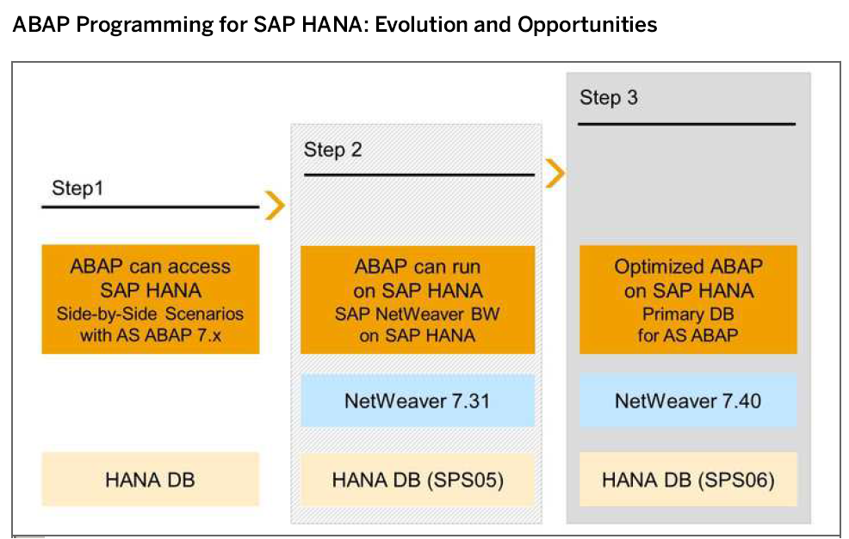
Evolution of ABAP for SAP HANA
Notes:
Add instructor notes here.

Slide 19
Evolution of ABAP for SAP HANA
Delivered as a globally available service release in December 2013, SPS 05 offers many new artifacts that ABAP developers can use to push down code to SAP HANA and bring innovation to their applications at various levels of abstraction.
Notes:
Add instructor notes here.

Slide 20
HANA Architecture
The SAP HANA database is developed in C++ and runs on SUSE Linux Enterprise Server.
SAP HANA database consists of multiple servers and the most important component is the Index Server.
SAP HANA database consists of Index Server, Name Server, Statistics Server, Preprocessor Server and XS Engine.
Notes:
Add the notes here.
Add instructor notes here.

Slide 21
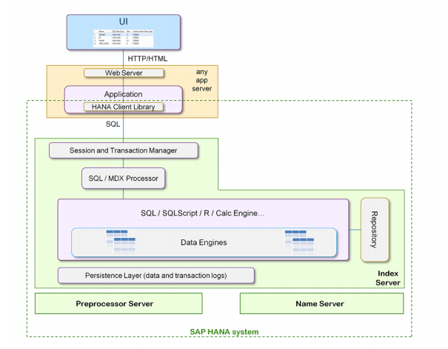
HANA Architecture
Notes:
Add the notes here.
Add instructor notes here.

Slide 22
HANA Architecture
Index Server:
Index server is the main SAP HANA database component
It contains the actual data stores and the engines for processing the data.
The index server processes incoming SQL or MDX statements in the context of authenticated sessions and transactions.
Persistence Layer:
The database persistence layer is responsible for durability and atomicity of transactions.
It ensures that the database can be restored to the most recent committed state after a restart and that transactions are either completely executed or completely undone.
Notes:
Add the notes here.
Add instructor notes here.

Slide 23
HANA Architecture
Preprocessor Server:
The index server uses the preprocessor server for analyzing text data and extracting the information on which the text search capabilities are based.
Name Server :
It owns the information about the topology of SAP HANA system.
In a distributed system, the name server knows where the components are running and which data is located on which server.
Statistic Server :
The statistics server collects information about status, performance and resource consumption from the other servers in the system.
The statistics server also provides a history of measurement data for further analysis.

Slide 24
HANA Architecture
Session and Transaction Manager:
The Transaction manager coordinates database transactions, and keeps track of running and closed transactions.
When a transaction is committed or rolled back, the transaction manager informs the involved storage engines about this event so they can execute necessary actions.
XS Engine:
XS Engine is an optional component.
Using XS Engine clients can connect to SAP HANA database to fetch data via HTTP.

Slide 25
SAP In-Memory
SAP HANA is an in-memory database:
It is a combination of hardware and software made to process massive real time data using In-Memory computing.
It combines row-based, column-based database technology.
Data now resides in main-memory (RAM) and no longer on a hard disk.
It’s best suited for performing real-time analytics, and developing and deploying real-time applications.
An in-memory database means all the data is stored in the memory (RAM).
The speed advantages offered by this RAM storage system are further accelerated by the use of multi-core CPUs, and multiple CPUs per board, and multiple boards per server appliance.
Notes:
Add the notes here.
Add instructor notes here.

Slide 26
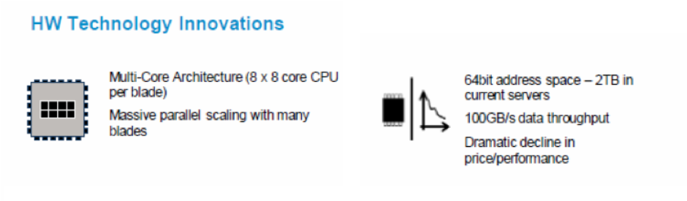
SAP In-Memory
SAP HANA is equipped with multiengine query processing environment which supports relational as well as graphical and text data within same system.
It provides features that support significant processing speed, handle huge data sizes and text mining capabilities.
Notes:
Add the notes here.
Add instructor notes here.

Slide 27
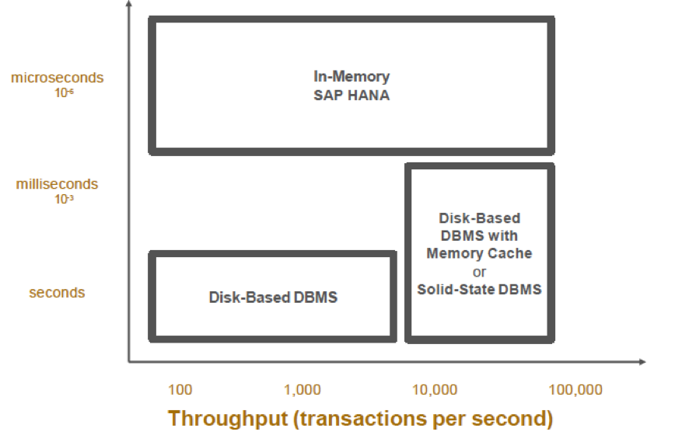
SAP In-Memory
Notes:
Add the notes here.
Add instructor notes here.

Slide 28
SAP HANA Database Concepts
A running SAP HANA system consists of multiple communicating processes (services).
The following shows the main SAP HANA database services in a classical application context.
Notes:
Add the notes here.
Add instructor notes here.

Slide 29
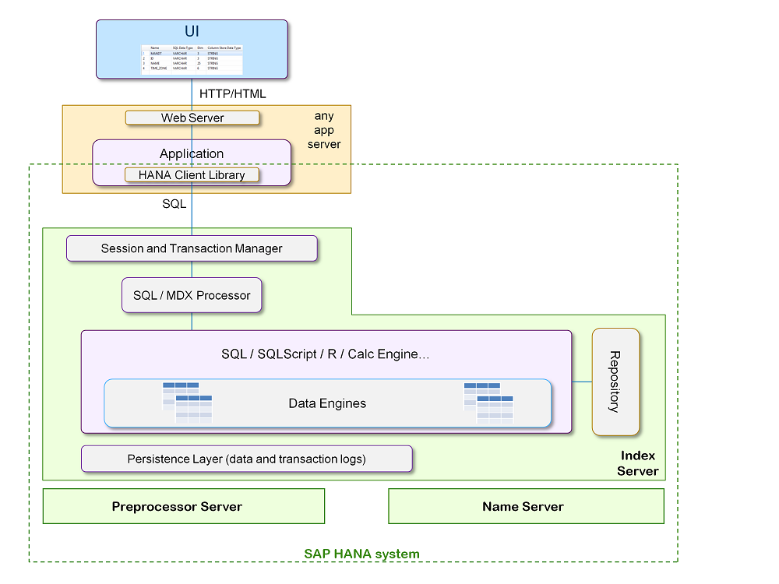
SAP HANA Database Concepts

Slide 30
SAP HANA Database Concepts
The SAP HANA database has its own scripting language named SQL Script.
SQL Script embeds data-intensive application logic into the database.
In addition to SQL Script, SAP HANA supports a framework for the installation of specialized and optimized functional libraries, which are tightly integrated with different data engines of the index server.
SAP HANA also supports the development of programs written in the R language.
Notes:
Add the notes here.
Add instructor notes here.

Slide 31
SAP HANA Database Concepts
The main SAP HANA database management component is known as the index server, which contains the actual data stores and the engines for processing the data.
The index server processes incoming SQL or MDX statements in the context of authenticated sessions and transactions.
Notes:
Add the notes here.
Add instructor notes here.

Slide 32
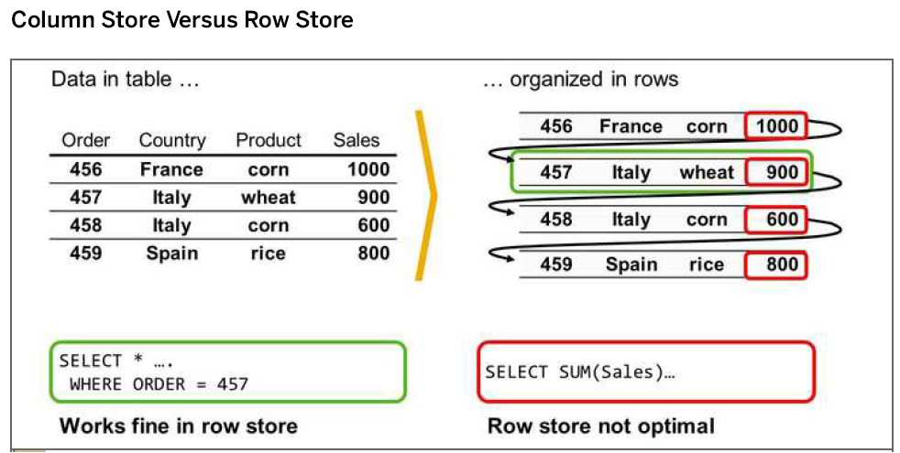
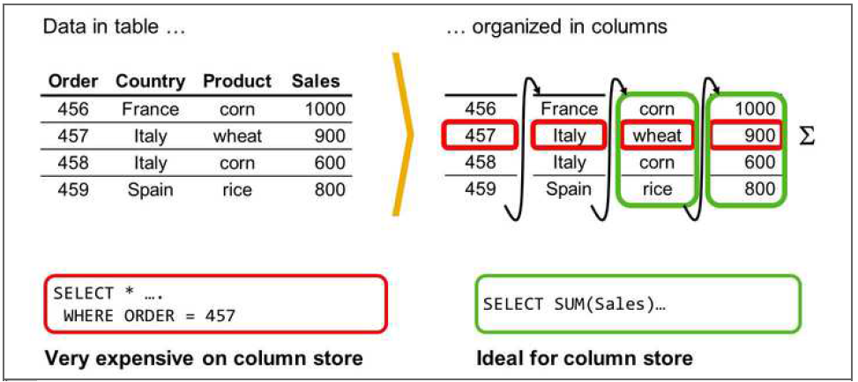
SAP HANA Database Concepts
Row and Column Store:
Row Storage - It stores table records in a sequence of rows.
Column Storage - It stores table records in a sequence of columns i.e. the entries of a column is stored in contiguous memory locations.

Slide 33
SAP HANA Database Concepts
SAP HANA Modeler Views can only be created on the top of Column based tables. Storing data in Column tables is not a new thing. Earlier it was assumed that storing data in Columnar based structure takes more memory size and not performance Optimized.
With evolution of SAP HANA, HANA used column based data storage in Information views and presented the real benefits of columnar tables over Row based tables.

Slide 34
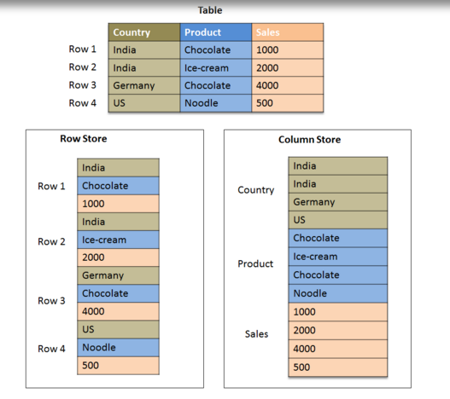
SAP HANA Database Concepts
Notes:
Add the notes here.
Add instructor notes here.

Slide 35
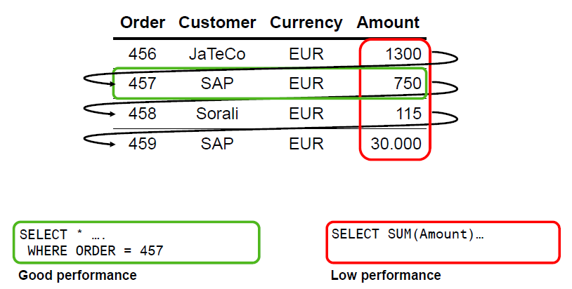
SAP HANA Database Concepts
Row Store :

Slide 36
SAP HANA Database Concepts
Column Store :
In a conventional database, data is stored in Row based structure i.e. horizontally. SAP HANA stores data in both row and Column based structure. This provides Performance optimization, flexibility and data compression in HANA database.
Storing Data in Columnar based table has following benefits:
Data Compression
Faster read and write access to tables as compared to conventional Row based storage
Flexibility & parallel processing
Perform Aggregations and Calculations at higher speed
Notes:
Add the notes here.
Add instructor notes here.

Slide 37
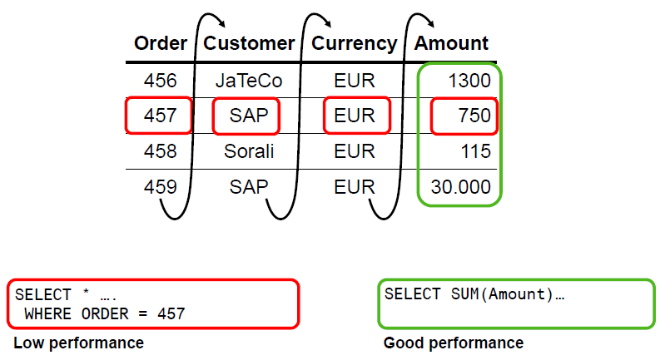
SAP HANA Database Concepts
Column Store :
Notes:
Add the notes here.
Add instructor notes here.

Slide 38
SAP HANA Database Concepts
It is always advisable to use Column based storage, if SQL statement has to perform aggregate functions and calculations. Column based tables always perform better when running aggregate functions .
Row based storage is preferred when output has to return complete row. The example given below makes it easy to understand.
While running a simple Select query, full row has to be printed in output so it is advisable to store table as Row based in this scenario.

Slide 39
SAP HANA Database Concepts
Traditional databases store data simply in rows.
The HANA in-memory database stores data in both rows and columns.
It is this combination of both storage approaches that produces the speed, flexibility and performance of the HANA database.

Slide 40
SAP HANA Database Concepts
Advantages of column-based tables:
Faster Data Access
Better Compression
Better parallel Processing
Advantages of Row Store :
The application typically needs to access a complete record (or row).
Neither aggregations nor fast searching are required.
The table has a small number of rows (e. g. configuration tables, system tables).
Notes:
Add the notes here.
Add instructor notes here.

Slide 41
SAP HANA Database Concepts
Disadvantages of Row Store:
In case of analytic applications where aggregation are used and fast search and processing is required. In row based tables all data in a row has to be read even though the requirement may be to access data from a few columns.

Slide 42
SAP HANA Database Concepts
Difference between Row and Column Store:
Property | Row Store | Column Store | Reason
Memory Usage | Higher | Lower | Compression
Transactions | Faster | Slower | Modifications require updates to multiple columnar
Analytics | Slower even if indexed | Faster | Smaller dataset to scan, inherent indexing

Slide 43
Database Compression :
The column store allows for the efficient compression of data. This makes it less costly for the SAP HANA database to keep data in main memory. It also speeds up searches and calculations.
Data in column tables can have a two-fold compression:
Dictionary compression
This default method of compression is applied to all columns. It involves the mapping of distinct column values to consecutive numbers, so that instead of the actual value being stored, the typically much smaller consecutive number is stored.
Advanced compression
Each column can be further compressed using different compression methods, namely prefix encoding, run length encoding (RLE), cluster encoding, sparse encoding, and indirect encoding. The SAP HANA database uses compression algorithms to determine which type of compression is most appropriate for a column. Columns with the PAGE LOADABLE attribute are compressed with the NBit algorithm only.

Slide 44
Database Compression :
Compression is automatically calculated and optimized as part of the delta merge operation.
If you create an empty column table, no compression is applied initially as the database cannot know which method is most appropriate.
As you start to insert data into the table and the delta merge operation starts being executed at regular intervals, data compression is automatically (re)evaluated and optimized.

Slide 45
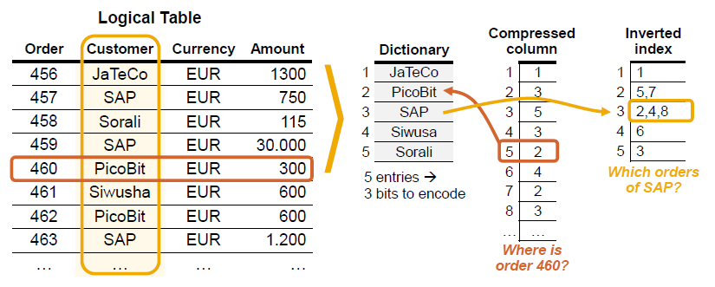
Database Compression :

Slide 46
Database Compression :
Automatic compression optimization is ensured by the parameter active in the optimize compression section of the indexserver.ini configuration file. This parameter must have the value yes.
To store the contents of a column, the SAP HANA database creates a minimum of two data structures:
>> a dictionary vector
>> an attribute vector

Slide 47
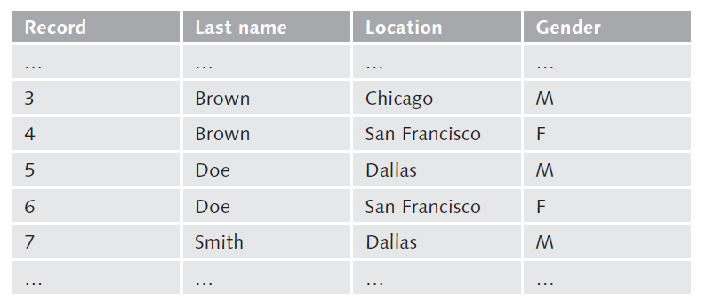
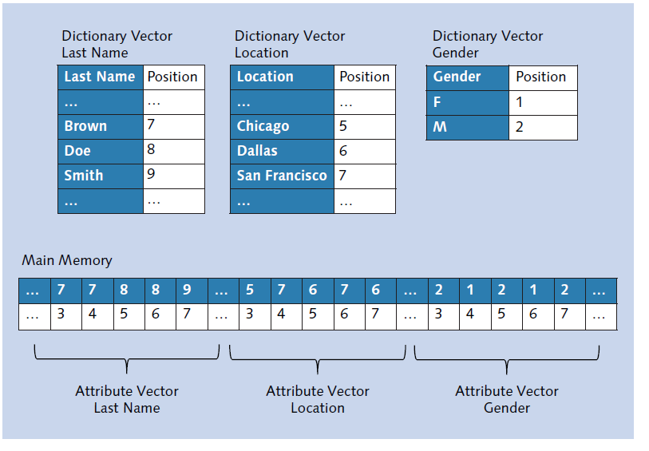
Database Compression :

Slide 48
Code Pushdown:
One of the key differences for developing applications in ABAP for HANA is that you can push down data intense computations and calculations to the HANA DB layer instead bringing all the data to the ABAP layer and the processing the data to do computations.
This is what is termed as Code-to-Data paradigm in the context of developing ABAP applications optimized for HANA.

Slide 49
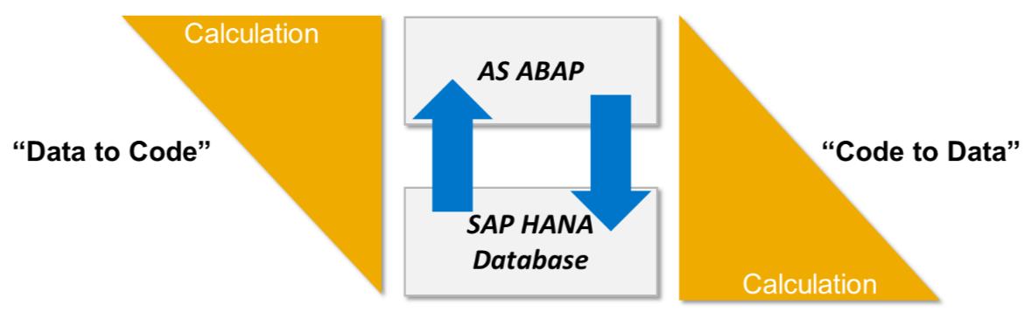
Code Pushdown:

Slide 50
Code Pushdown:
Code-to-Data Paradigm
Code-to-data paradigm is basically a programming style in ABAP where you code to ‘push down’ data intensive computations and calculations to the HANA DB layer, instead of bringing all the data to the ABAP layer and then processing the data to do computations.
When you plan to migrate to SAP HANA, the amount of custom code in your system will have an impact on total cost, time and the quality of the end result. In this article, we look at the potential impact of that custom code, and discuss how to tune your custom code to perform optimal on SAP HANA. By using the tips and tools mentioned here, you will be able to boost your ROI and smoothen the migration process.

Slide 51
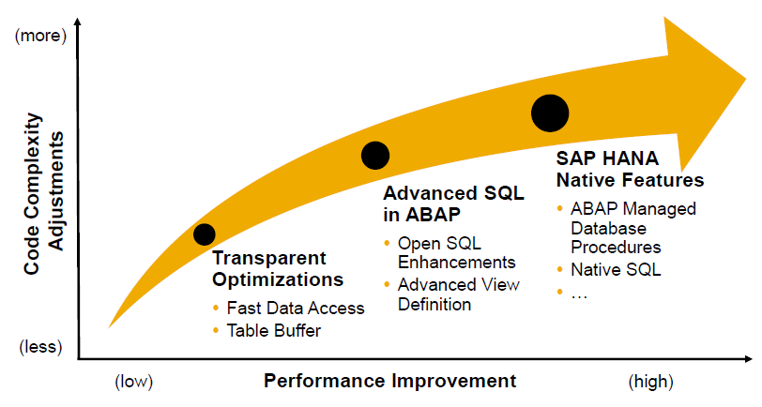
Code Pushdown:
Code to Data – Performance Vs Code Adjustments :

Slide 52
Data Provisioning:
Data provisioning involves importing data from multiple SAP and non-SAP system into SAP HANA.
For HANA, we can divide the data provisioning options available into two categories, they are:
SAP HANA in-built tools
External Tools

Slide 53
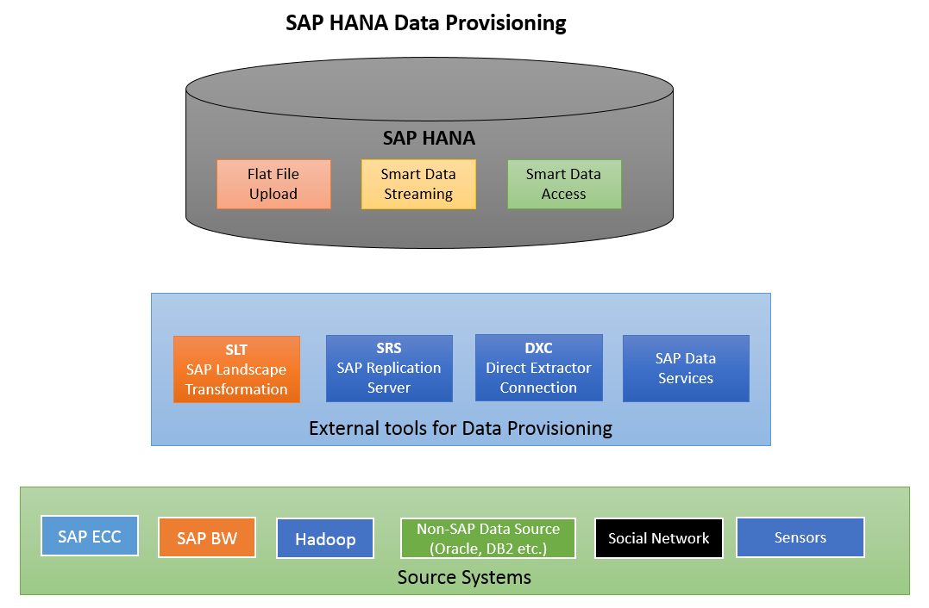
Data Provisioning:
The pictorial representation of data provisioning techniques currently available to us for HANA.

Slide 54
Data Provisioning:
SAP Landscape Transformation Replication Server (“SLT”)
is for all SAP HANA customers who need real-time or scheduled data replication, sourcing from SAP and NON-SAP sources
Uses trigger-based technology to transfer the data from any source to SAP HANA in real-time.
SLT server can be installed on the separate system or on SAP ECC System.

Slide 55
Data Provisioning:
SAP Replication Server (SRS)
also known SAP Sybase Replication Server is a real-time data integration and movement software.
SAP Replication Server (SRS) moves and synchronizes transactional data including DML and DDL across the enterprise, providing low impact, guaranteed data delivery, real-time business intelligence, and zero operational downtime.

Slide 56
Data Provisioning:
Direct Extractor Connection data replication
reuses existing extraction, transformation, and load mechanism built into SAP Business Suite systems via a simple HTTP(S) connection to SAP HANA.
It is a batch-driven data replication technique.
It is considered as method for extraction, transformation, and load with limited capabilities for data extraction.

Slide 57
Data Provisioning:
SAP Data Services
Gives a single enterprise level solution for data integration, transformation, data quality, data profiling and text data processing which allows us to:
Build a trusted data warehouse platform using data integration, data transform and data profiling
Provides single graphical user interface application for developers to build everything in the system.

Slide 58
DATA Provisioning Method Summary.
Method | Flat File Upload | SLT | ETL (BODS) | Sybase Replication | DXC
Use Case | Prototyping and Testing | Productive Usage | Productive Usage | Productive Usage | Productive Usage
Focus | Agility | Real-time | Extraction and Transformation | Real-time | Re-usability of SAP Content
Transformation Capabilities | None(1:1) | Default(1:1, conditional filtering and little transformation possible | Full range - support complex transformations | None(1:1) | Limited to function defined within function module of SAP Data Source

Slide 59
Summary
In this lesson, you have learnt:
Basic Concepts Of SAP HANA
Architecture Of SAP HANA
In Memory Concept Used In SAP HANA
Row And Column Storage In SAP HANA Database
Data Provisioning.
Notes:
Add the notes here.
Add instructor notes here.

Slide 60
Review Question
SAP HANA Studio provides an environment for Administration, Modeling and Data Provisioning. (True/False)
SAP HANA is a ___________ database.
Real time replication supported by ___________.
For small and extensive write operations,________ store is advisable.
SLT uses _____ technology to transfer data.
Notes:
Add the notes here.
Add instructor notes here.

Slide 61
Review Question
The SAP HANA database is developed in ______ and runs on ______ Server.
SAP HANA database consists of ______ Server, _____ Server, ______ Server, _________ Server and _______ Engine.
SAP HANA database cannot store more than _______rows for a non-partitioned table.
Notes:
Add the notes here.
Add instructor notes here.

